Slide 1
Keeping the lights on during M&O projects.

Slide 2
MAINTENANCE and OPERATIONS
M&O
DelDOT Maintenance and Operations is one side of the DelDOT family.
M&O is responsible for various repair and upgrade projects that are performed by in-house and contractor forces.
An M&O project time frame is generally days to weeks, as opposed to months and years for capital projects.

Slide 3
Some Notes For M&O Projects
Most of M&O’s work is not planned.
Often, M&O must initiate work immediately due to a safety hazard, road closure or Legislative complaints.
Work Order Generation to Construction happens very fast and must include Design, Traffic Planning, Environmental Permits, Utility Coordination, Public Outreach, Survey, etc.
Replacing infrastructure in-kind is usually the first option, but not always best solution.

Slide 4
Some More Notes For M&O Projects
Some utility conflicts are not known until midway through construction when materials are already on site, or halfway installed. When Utility conflicts are found, M&O responds and reaches out as quickly as possible to produce a solution.
Utility companies have provided schematics in the past that have greatly helped in the field and enabled M&O to move forward
Most of M&O’s work is in close proximity to utilities, and M&O does its best to have the Contractor coordinate with utility and support existing utilities as needed.
M&O tries to only involve the Utility Section in critical situations.

Slide 5
DELDOT STANDARD SPECIFICATIONS
104.14 Required Notifications for Disturbing Property and Using Bridges.
  A. (The Contractor shall)Provide 2 weeks’ notice to property owners before removing any fixture, shrub, or other object from a right-of-way or easement area that may belong to the property owners. If the owners do not attempt to salvage this property within the 2-week period, remove it without further obligation.
  THIS NOTICE INCLUDES ANY DISRUPTION TO ANY UTILITY SERVICE TO THE HOME/BUSINESS.

Slide 6
Utility Company Policy
Follow YOUR Company policy for a short-term outage.
DelDOT recommends also providing notice to your customers for any scheduled outage. You know how your system is operated – and who will be out of service.
Be prepared for a longer-term outage. Have a plan “B” ready.
REMEMBER - the difference between a short-term and longer-term outage is one broken hydraulic hose on the piece of equipment in use.

Slide 7
214 Northbend Court 7Jan – 1 Feb 2020
The Corrugated Metal Pipe (CMP)had rusted out and was failing from CB20 to the pond outfall.
An electrical transformer, a CATV pedestal and a telephone pedestal were installed directly over the failing CMP. All of these at-grade facilities needed to be removed to allow for the pipe replacement, within the same footprint.
This transformer directly fed 4 houses.

Slide 8
Construction Plan
Utility Company Plan
20’ storm drainage easement

Slide 9
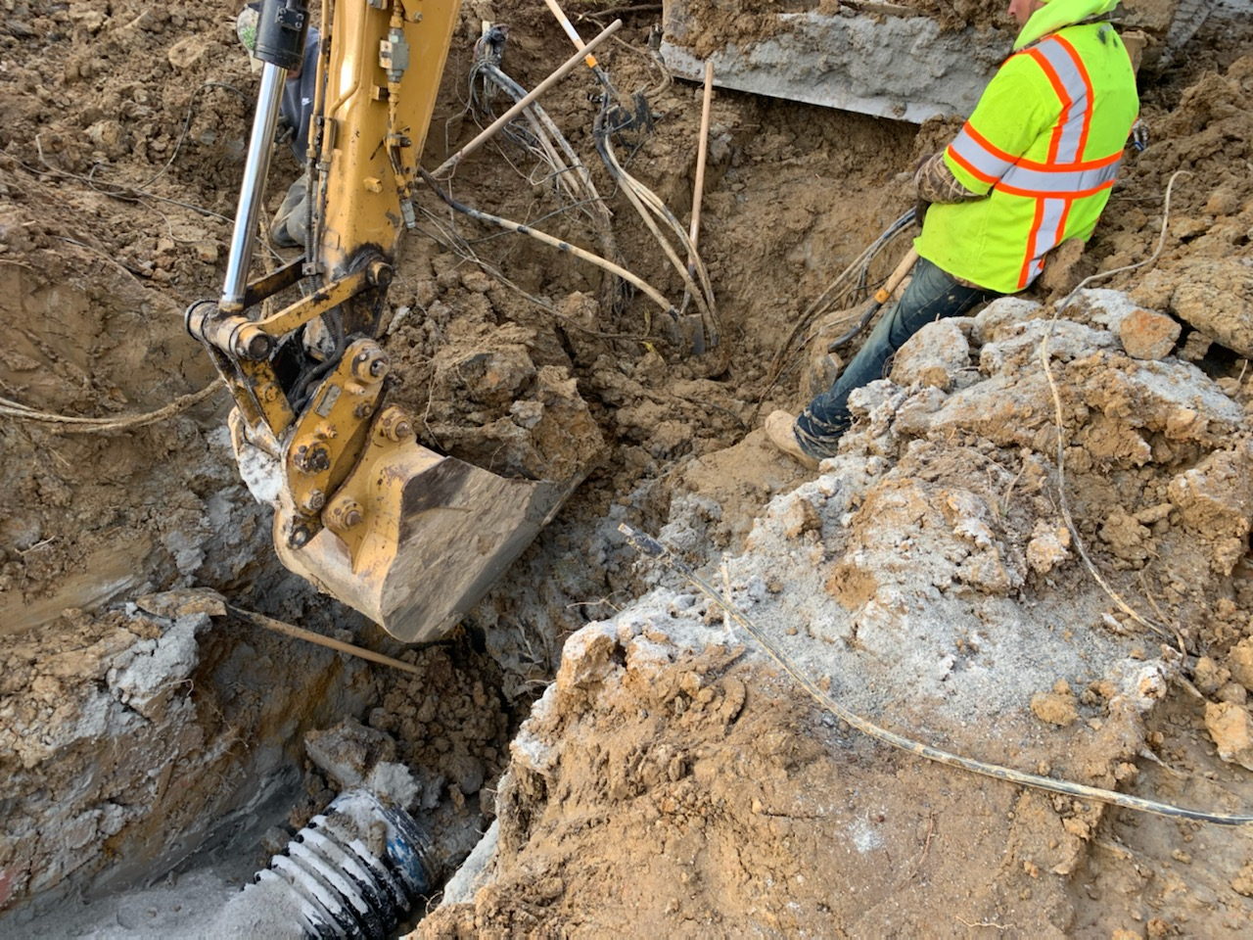

Slide 10
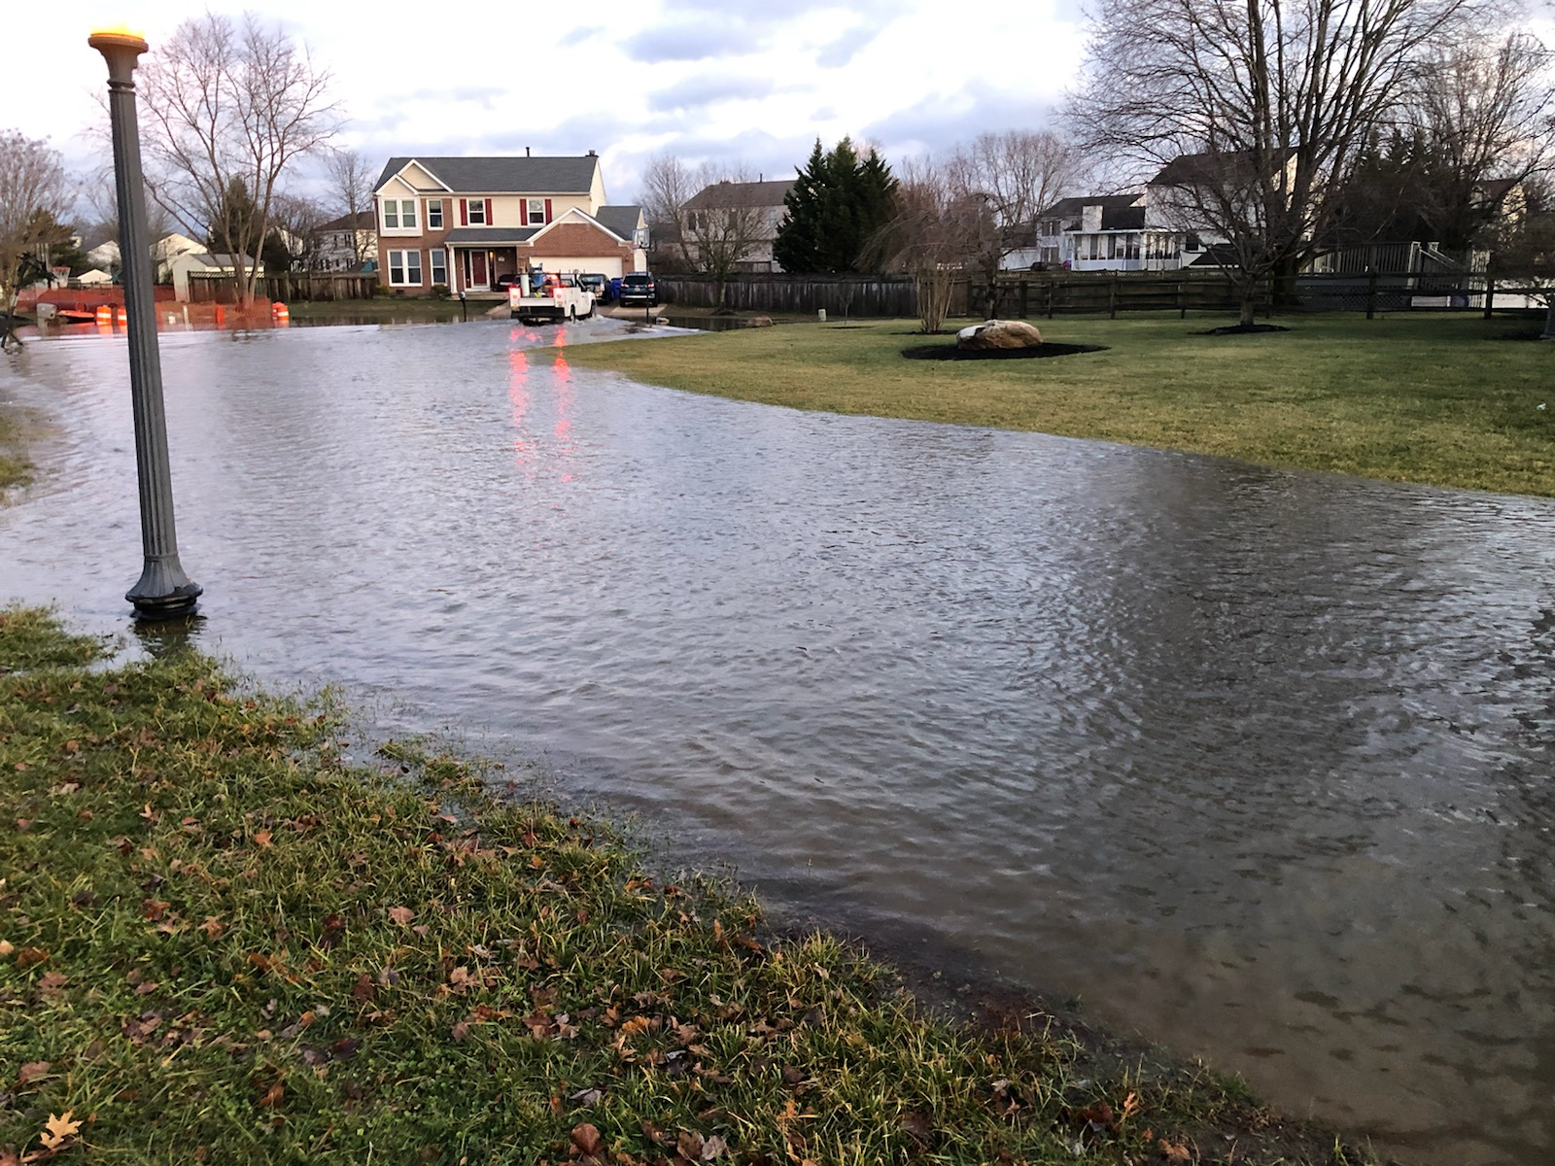

Slide 12
214 Northbend Court 7Jan – 1 Feb 2020
Lessons Learned –
Wet ground conditions = slower pace of work
Maintain constant drainage path
Often weather from outside of Delaware can affect a utility’s ability to respond to a DelDOT project.
A transformer over a drainage pipe will cause a less than ideal excavation area for the construction crew.
Always factor in more time in the construction schedule than originally thought, if utilities are in the direct path of the drainage pipe to be replaced.

Slide 13
Front Street - Milton
And now for some good news. A drainage project that went according to plan. Front Street – Milton
The DelDOT Utility Section was notified on 5 May 2020 of the failing pipe on Front Street in Milton.
Front Street was closed to traffic on 5 Oct 2020 for the actual pipe replacement.
In-between these dates, DP&L, Verizon and Comcast each designed and implemented a plan to maintain service to their customers and not to conflict with the construction project. – THANK YOU

Slide 14
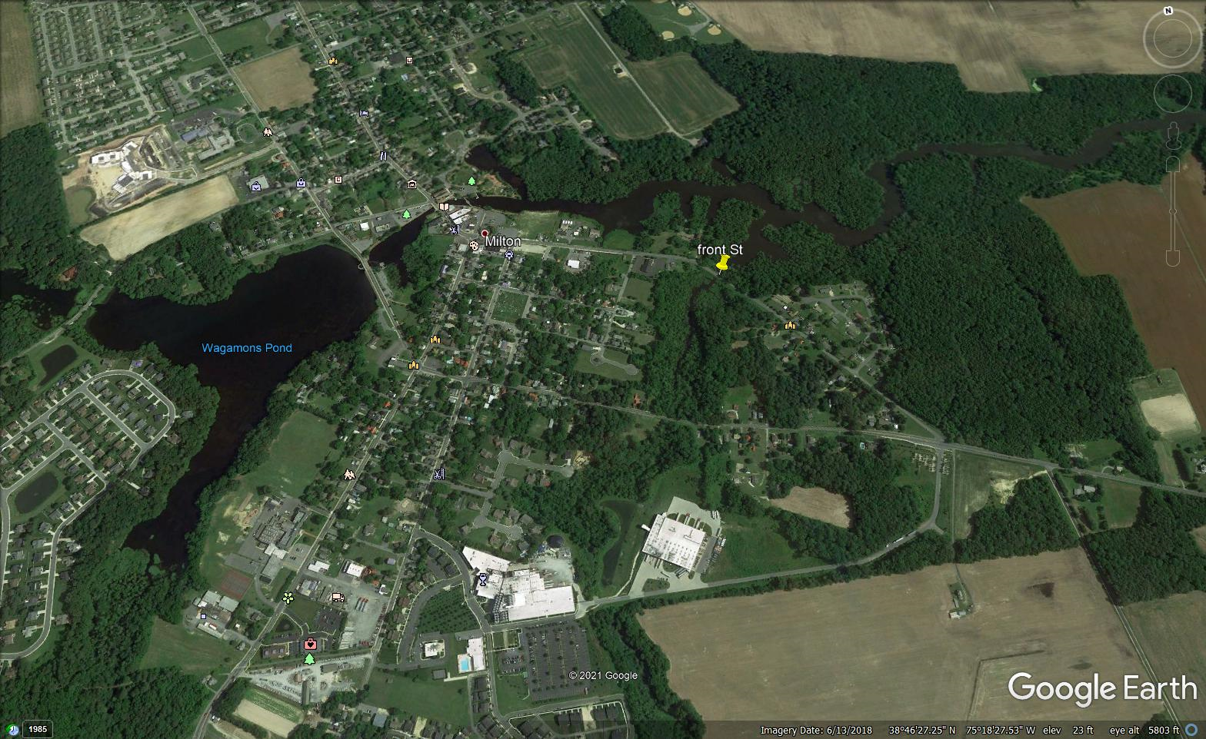

Slide 16
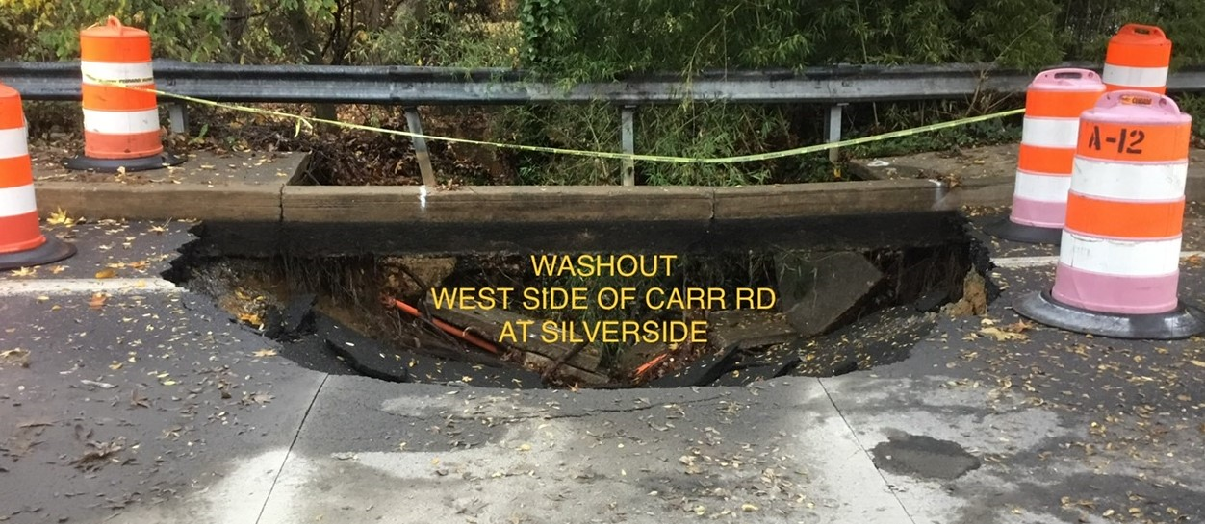
A completely different situation – Carr Road
11/11/2020 – Pipe failure resulting in Carr Road being closed.

Slide 17
11/12/2020 – Contractor called in Emergency Miss Utility Tickets.
11/13/2020 – Contractor Test pitted to locate Utilities.
  Trouble locating water line. Suez Water was contacted and arrived to assist in locating. Contractor found water line outside limits of mark-out.
  Also found two unmarked gas lines.
  Orange conduit seen in sinkhole but was not marked or identified. Possibly abandoned?
  Deteriorated duct bank marked and located near centerline of road
  All located utilities to this point were found above existing pipe crossing.

Slide 18
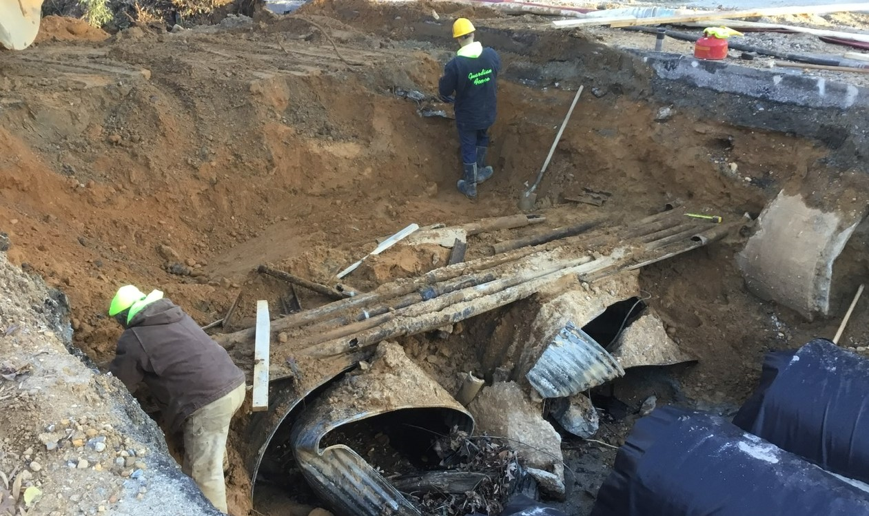

Slide 19
Carr Road
Lessons Learned
Utilities do not always know exactly where their facility is located.
Maintain an open line of communication with the contact for the utility company in case there are any problems.
Just because Miss Utility does not mark a location, does not mean that there is nothing there.
If a utility line is “retired in place” or “abandoned”, the facility is still the property of the utility.

Slide 20
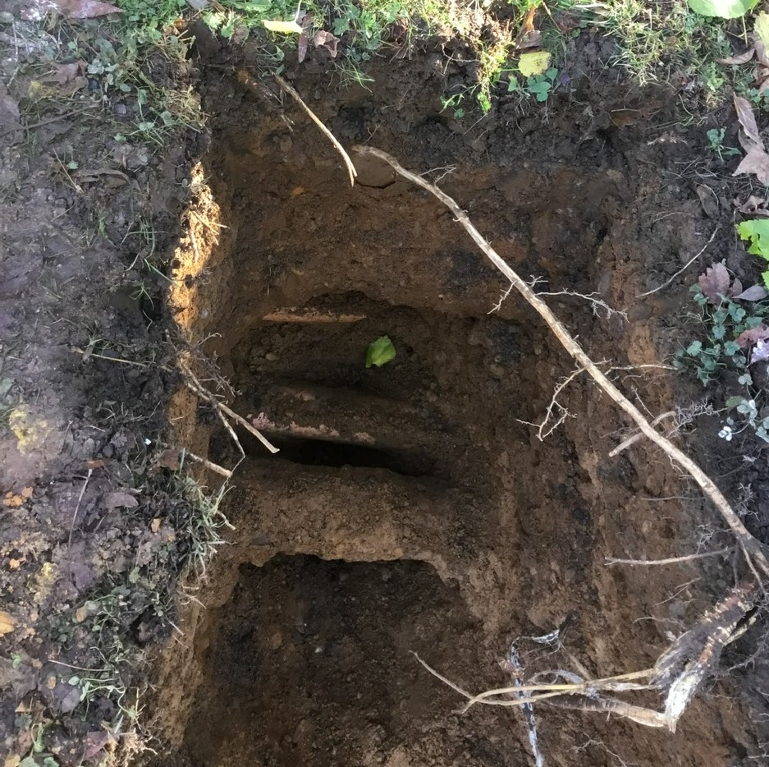
Which utilities in this trench are live and which are retired in place?
NO ONE KNOWS!

